Slide 1
Page block dataset classifications
By: Chantha, Vyas, Jesus and Muhammad

Slide 2
Page Block Data set overview
The main objective of the data set is to classify all blocks of a page layout of the document that has been detected by a segmentation process.
The five classification classes for the dataset are :
1. text
2. horizontal line
3. picture
4. vertical line
5. graphic
This dataset contains 5473 of data instances.

Slide 3
Technology and library used for this project
Programming Language used: Python
Python Library used:
Pandas: helps with data manipulation and data storing
Numpy: helps with mathematical computation on array and matrices
Matplotlib: data visualization
Keras: Neural Net library
Sci-kit learn: simple/efficient tool for data analysis, provides various classification methods

Slide 4
Decision Trees
The Decision Tree Method breaks down a dataset into smaller and smaller subsets while at the same time an associated decision tree is incrementally developed.
I utilized the sklearn library to create functions such as the label encoder, the metrics, and the decision tree classifier.
I used 2 metrics for choosing how to split the tree:
Gini Impurity
Entropy
After using both methods, we observe that Entropy usually gives a slightly higher accuracy rate compared to Gini.
Notes:
decision node :branches. Leaf node: classification or decision.

Slide 5
Procedure
Import Libraries and Load the dataset.
Separate independent and dependent columns into X and y variables.
Create a Label Encoder, and initialize an array to store the accuracies for the 10 models.
Apply the following twice. Once using the gini metric and once using entropy.
Run the decision tree classifier using the built-in sklearn functions.
Apply the 10-fold cross validation.
Scale and train each model in the cross validation iteration.
Add the resulting accuracy of the current model to the array.
Print the array of the accuracies and print the mean.

Slide 6
Decision Tree : Accuracy Rates
Entropy
Model 1: 0.9525547445255474
Model 2: 0.8777372262773723
Model 3: 0.9178832116788321
Model 4: 0.9414990859232175
Model 5: 0.9104204753199269
Model 6: 0.8190127970749543
Model 7: 0.7074954296160878
Model 8: 0.8939670932358318
Model 9: 0.9012797074954296
Model 10: 0.8427787934186471
Mean: 87.64628564565847% accuracy
Gini
Model1: 0.8722627737226277
Model 2: 0.8613138686131386
Model 3: 0.8686131386861314
Model 4: 0.7586837294332724
Model 5: 0.8464351005484461
Model 6: 0.9542961608775137
Model 7: 0.8592321755027422
Model 8: 0.7477148080438757
Model 9: 0.9177330895795247
Model 10: 0.8281535648994516
Mean: 85.14438409906724% accuracy

Slide 7
kNN (k Nearest Neighbor)
Non-parametric and lazy learner
Procedure:
Run an initial data training
Use elbow method to get the best k value and utilize the chosen k value
Run k fold cross validation
Apply 10 fold cross validation
Scale each models in the cross validation iteration
Train each models in the cross validation iteration
Compute the accuracy of the model then append it to a list
Compute the mean of the accuracy list

Slide 8
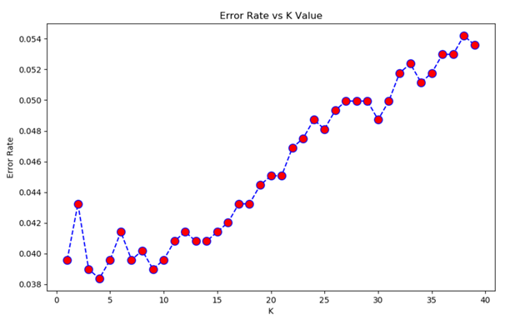
kNN - Error Rate using Elbow method
Elbow methods take the average rate of prediction that is not equal to the test value for all possible k value in a given range.
Based on this error rate plot, we can see that when k=3, we get the lowest rate of error.

Slide 9
kNN - Accuracy Rate
Accuracy rate for each model:
Model 1: 0.9653284671532847 Model 2: 0.9653284671532847 Model 3: 0.9525547445255474 Model 4: 0.946983546617916 Model 5: 0.9542961608775137 Model 6: 0.903107861060329 Model 7: 0.9140767824497258 Model 8: 0.9689213893967094 Model 9: 0.8811700182815356 Model 10: 0.9670932358318098
Average accuracy rate for the dataset: 94%

Slide 10
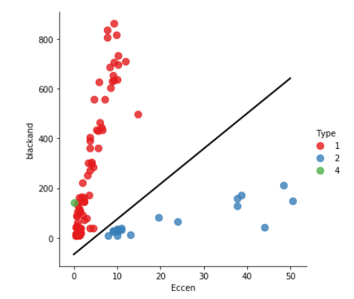
Support Vector Machines
Procedures:
Read dataset and loaded it into a dataframe
Separate the data to not include our classification
features = ['Height', 'Length', 'Area', 'Eccen', 'p_black', 'p_and', 'mean_tr', 'blackpix', 'blackand', 'wb_trans']
target = ['Type']
Normalized data values between 0 and 1
Split data into a training and testing data set
Trained model using a linear kernel with a C value of 2
Large Value of parameter C -> small margin
Small Value of parameter C -> large margin
Best results were with C being set to 4
Ran 10 fold validation test
Since our data is highly dimensional and large I plotted what the vector would look like with only 100 samples and 2 features.

Slide 11
SVM Results
Kernel | Linear | Radial Basis Function
1 | 0.9324817518248175 | 0.9452554744525548
2 | 0.9452554744525548 | 0.9397810218978102
3 | 0.9434306569343066 | 0.9233576642335767
4 | 0.9524680073126143 | 0.9323583180987203
5 | 0.9396709323583181 | 0.9177330895795247
6 | 0.9597806215722121 | 0.9396709323583181
7 | 0.9488117001828154 | 0.9451553930530164
8 | 0.9195612431444241 | 0.943327239488117
9 | 0.9542961608775137 | 0.923217550274223
10 | 0.946983546617916 | 0.9213893967093236
Avg K Fold Score: | 0.9442740095277493 | 0.9331246080145185
Support Vector Machines
Pros:
Good at high dimensional data
Works well on small data sets
accurate
Cons:
Isn’t suited to larger datasets as the training time with SVMs can be high
Less effective on noisier datasets with overlapping classes

Slide 12
Neural Network
Steps:
Import the dataset
Separate the dataset into independent and dependent variables .
Encoded the dependent variable
Used 10 -k fold to train the training set.
Created an ANN model
Input layer - 10 Nodes
One Hidden layer - 6 Nodes
Output layer - 5 Nodes
Scale the training set
Fit the X_training to the model
Stored the 10 accuracy in an array
Find the mean and the standard deviation
Predict the X_test
Created a confusion matrix
Repeat for other algorithms

Slide 13
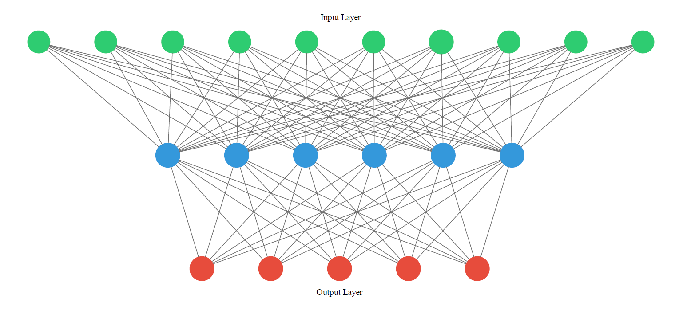

Slide 14
10-k fold validation
Kernel | RELU | ELU | TANH
1 | 95.62% | 95.62% | 94.34%
2 | 94.16% | 93.80% | 93.98%
3 | 95.26% | 95.26% | 94.71%
4 | 95.43% | 95.61% | 97.07%
5 | 97.07% | 97.44% | 96.89%
6 | 96.53% | 97.81% | 96.53%
7 | 94.33% | 95.61% | 95.61%
8 | 95.80% | 94.33% | 97.07%
9 | 96.16% | 96.16% | 95.61%
10 | 97.26% | 97.07% | 97.07%
Avg K Fold Score | 95.76% | 95.87% | 95.89%

Slide 15
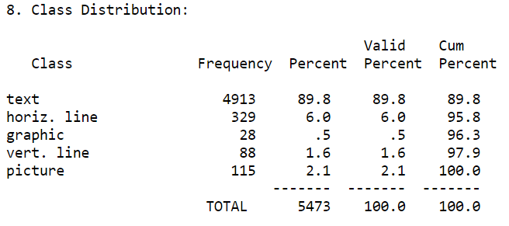
Summary/Conclusion
In conclusion, each classification algorithm achieved relatively high percentage of accuracy
None of the algorithm really outperform one another due to the distribution of the classifications in the dataset. 89% of the instances can be map back to text classification

